Slide 1
Racial Equity & Disparities Research/CAB Workgroup
April 7, 2021

Slide 2
Agenda
Updates
    Leadership
    Literature review paper
Program Level CAB (“PL-CAB”): Review of draft items
Data on client race
Plan for next meeting (May 5)

Slide 3
Research Review Article
    Goal:
    Provide a “state of the knowledge” around early psychosis and race, ethnicity, disparities and related topics in the U.S.
    Serve as a resource to us and others as we design studies and write articles
    Possibly: Use resources to create a (curated?) public database of research and assessments as part of a future grant/public engagement strategy
    Target journal: Psychiatric Services, 6000 word limit
    Approach:
    Work managed in a shared Google spreadsheet
    Divide into separate work teams to cover different topics
    Use parallel process to search (same search terms for race, clinical population)
    Document PRISMA flow (Preferred Reporting Items for Systematic Reviews and Meta-Analyses)
    Submit drafts
    Integration and synthesis by Neely and editorial team

Slide 4
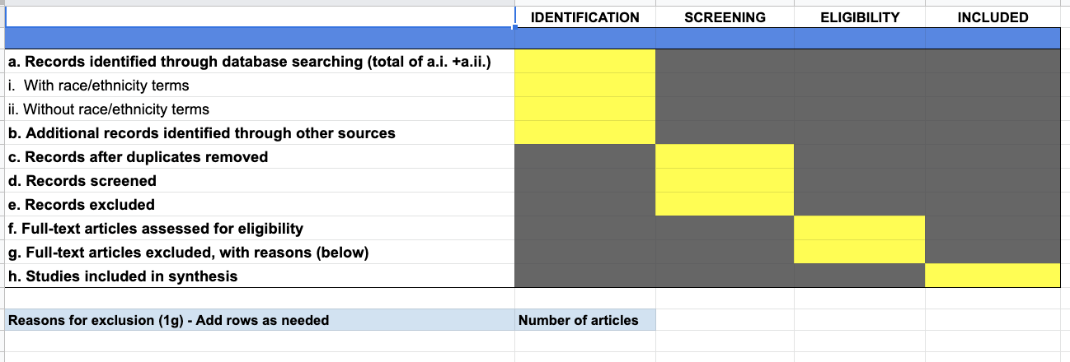
Modified PRISMA

Slide 5
Review Paper Section Teams
Service Utilization of FEP or TAU | Recovery and Outcomes | Service Provider Characteristics & Service Delivery | Family customs, culture & family involvement in treatment
Deepak Sarpal | Piper Meyer-Kalos | Dan Shapiro | Iruma Bello
Matthew Hutnyan | Tiana Sepahpour | Katie McCormick | Donna Bencivengo
Jess Taylor | Anita Kwashie | Swati Nayar | Hong Ngo
Emily Stein | Ariel Currie | Preethy George | Stephen Smith
Marne Chacon | Laura Tully | Shaun Davis | Lisa Dixon
Justin Wilkey | Arun Nagendra

Slide 6
Program Level Data Collection
Goal: Obtain program, clinic and agency characteristics across the 100+ clinics to describe key aspects of each and facilitate analyses related to aspects of implementation.
Mechanism: A form or questionnaire, collected at multiple time points -- details to be determined by the Steering Committee in the upcoming months.
Current status: Steering Committee is providing feedback, to be integrated into a revised version by
Today’s task:
  Are the questions relevant to race, ethnicity, disparities, equity and other related areas that are currently included (items 39-45) the “right” ones? Can we wordsmith some of these to improve them?

Slide 7
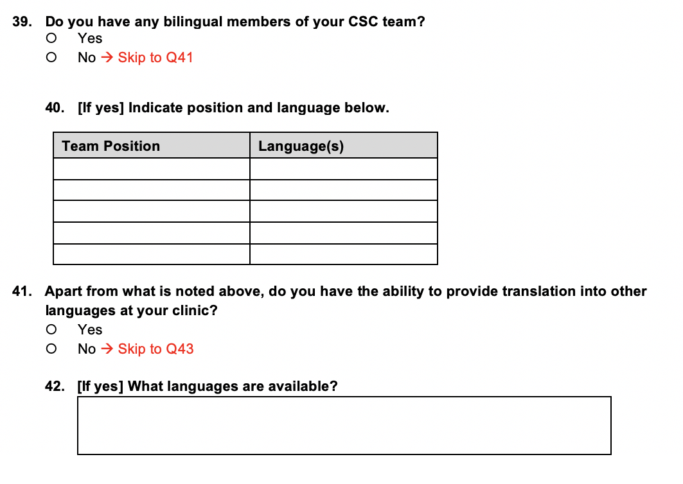

Slide 8
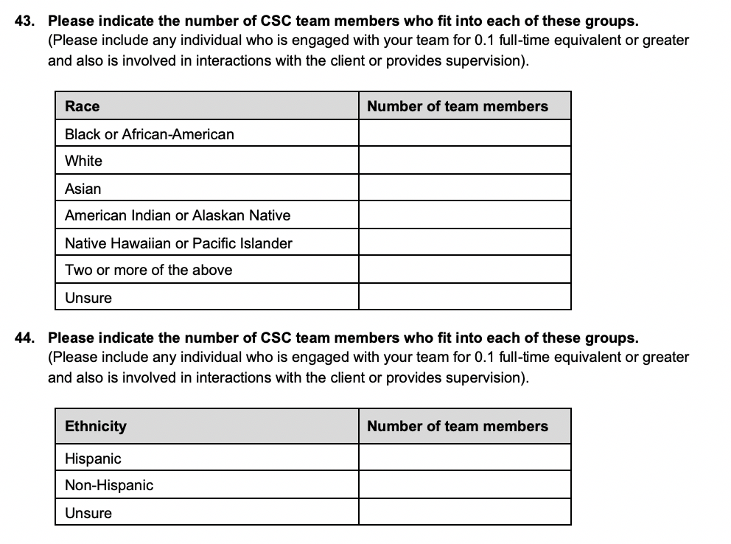
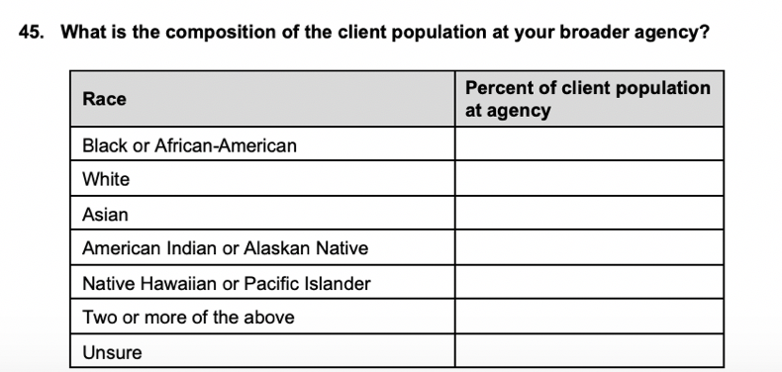

Slide 9


